Slide 1
Lecture #2 exploratory data analysis using python best EDA libraries
DATA MINING

Slide 2
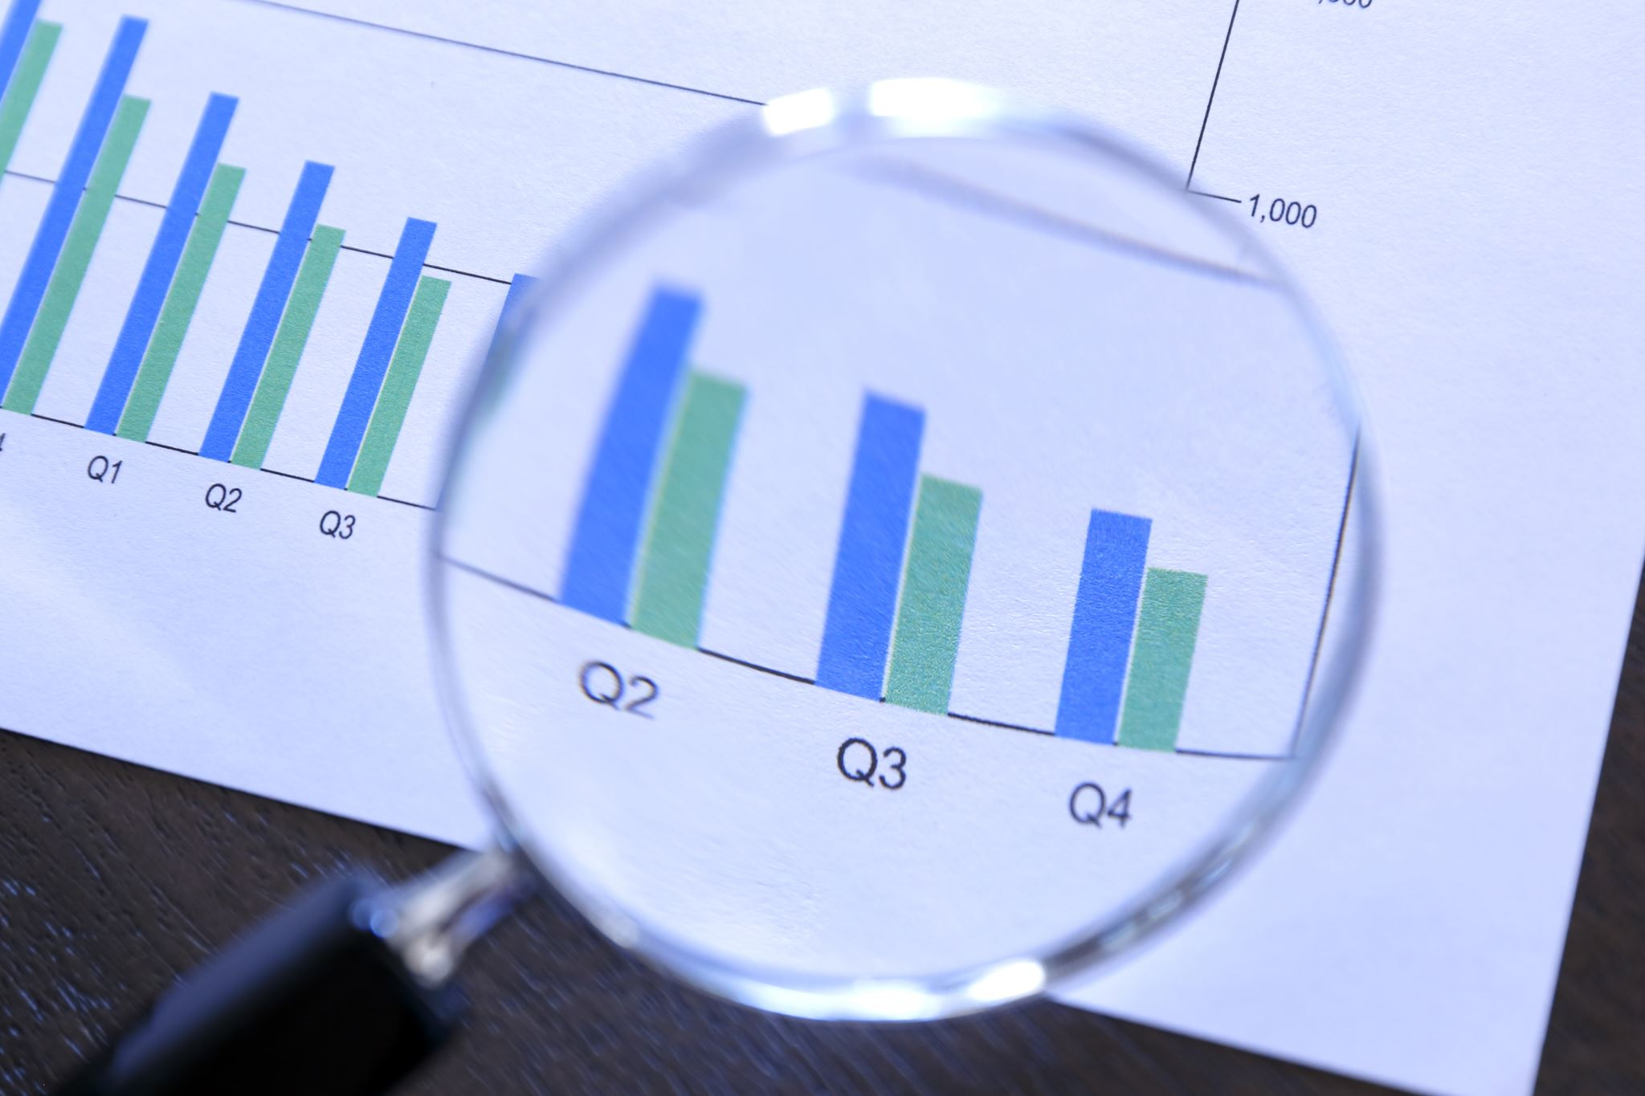


EXPLORATORY DATA ANALYSIS
Exploratory Data Analysis or EDA is an important initial step in any data science or analytics project. The goal of EDA is to explore and understand the data to learn about its characteristics and identify useful insights and patterns. This helps form appropriate hypotheses and guides subsequent modeling and analysis steps.

Slide 3


Python libraries for EDA
There are several Python libraries that can help perform EDA. We are using Autoviz, Sweetviz, ydata-profiling and dtale libraries for EDA of a chocolate dataset.

Slide 4

autoviz
Autoviz automatically generates visualizations to understand univariate (single variable) and bivariate (two variable) relationships. It displays histograms, scatterplots, correlation matrices and more. This provides a quick high-level overview of the data.

Slide 5
sweetviz
Sweetviz generates a detailed interactive HTML report to profile and visualize each variable. It analyzes metrics like distribution, missing values, duplicates, correlations to understand each attribute. This helps identify anomalies, relationships and data quality issues. Target variables can also be specified.

Slide 6

Pandas-profiling
Pandas-profiling provides a comprehensive profiling report object containing statistics, diagrams and observations for each attribute. Metrics like types, missing values, distributions, memory usage are analyzed. The report can be saved to HTML for sharing.

Slide 7

D-tale
Dtale is an interactive visualization library that launches a web application for exploring dataframes in the browser. It allows selecting rows, aggregations, filtering, sorting. This provides flexibility to iteratively analyze data from different angles.

Slide 8

Importance of exploratory data analysis
EDA is important as it helps gain initial insights, understand data characteristics, identify patterns, find relationships and data quality issues. This information guides subsequent data cleansing, feature engineering, model selection and evaluation steps. EDA identifies interesting variables for analysis and reduces risk of drawing incorrect conclusions. It forms a plan for the rest of the analysis process.

Slide 9



Metrics of each library

Slide 10

Autoviz metrics:
Autoviz:
Histograms - univariate distributions of continuous and categorical variables
Scatterplots - bivariate relationships between numeric variables
Correlation matrix - strength and direction of relationships between all numeric columns

Slide 11

Sweetviz metrics:
Sweetviz:
Type - data type of each attribute
Missing values - count and percentage of missing values
Duplicates - count of duplicate rows
Distribution - shape of univariate distributions (normal, skewed etc)
Outliers - presence of extreme values away from distribution
Longest/shortest values - details on text attributes
Memory usage - size of each attribute
Correlations - strength and direction between numeric columns

Slide 12

Pandas-profiling metrics
Ydata profiling:
Type - data type, presence of nulls, unique counts
Distribution - univariate shape, percentiles, extremes
Memory usage - bytes consumed by each column
Sample - preview of row data
Statistics - mean, median, mode, min, max, range
Graphs - histograms, boxplots for each numeric attribute

Slide 13

D-tale
Dtale:
Dataframe viewer - ability to select rows, columns dynamically
Filters - subset data based on conditional criteria
Descriptive stats - count, mean, median, mode, max, min etc
GroupBy - aggregation using column filters
Histograms - univariate distributions
Relationships - scatterplots between numeric columns

Slide 14
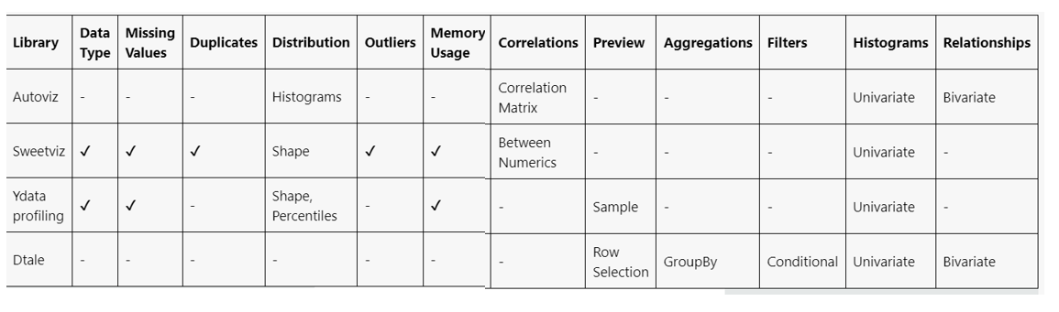
Comparison b/w libraries

Slide 15
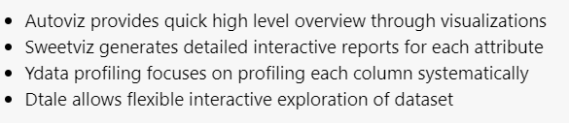
When to use which library:

Slide 16
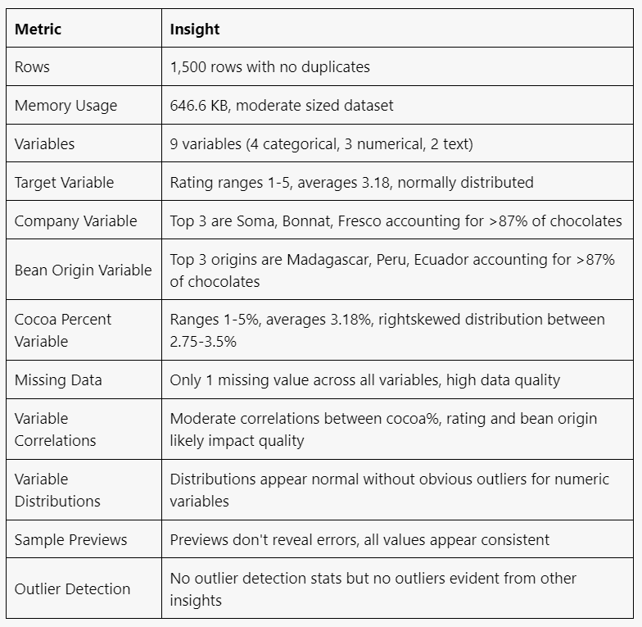
Insights from Sweetviz report

Slide 17
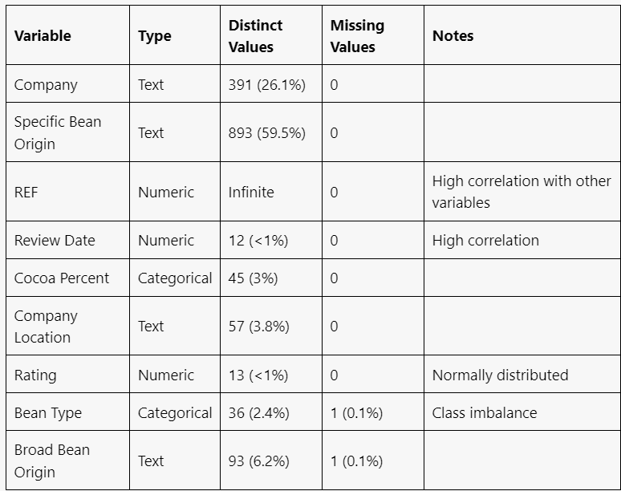
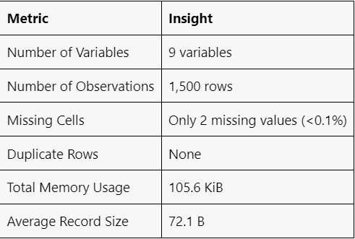
Pandas-profiling insights

Slide 18

High correlation indicates?
Linear relationship: The values of the two variables change in a predictable linear fashion with each other. As one increases, the other tends to increase or decrease consistently.
Strong association: There is a strong statistical association or connection between the two sets of values. Their movements are interrelated rather than independent.
Co-dependence: The variables are co-dependent and influence each other to a significant degree. A change in one coincides with or causes a change in the other.
Predictability: The value of one variable allows reasonable prediction of the other. Knowledge about one provides information about the likely value of the other.

Slide 19
Features analysis
Feature analysis, also known as feature engineering or feature selection, is the process of selecting and preparing the most relevant features (variables or attributes) from a dataset to improve the performance of a machine learning model. Feature analysis plays a crucial role in building effective and efficient predictive models.

Slide 20
What is the role of threshold in feature engineering
In feature analysis, the threshold value plays a crucial role in feature selection and feature engineering. It helps determine which features are considered relevant or important for building predictive models. The threshold value is used to filter out features based on certain criteria, such as statistical measures, importance scores, or performance metrics.
Filter Methods: In filter methods for feature selection, threshold values are used to determine the importance of features based on statistical measures such as correlation, chi-square, or mutual information. Features that exceed the threshold are retained, while those below the threshold are discarded.

Slide 21
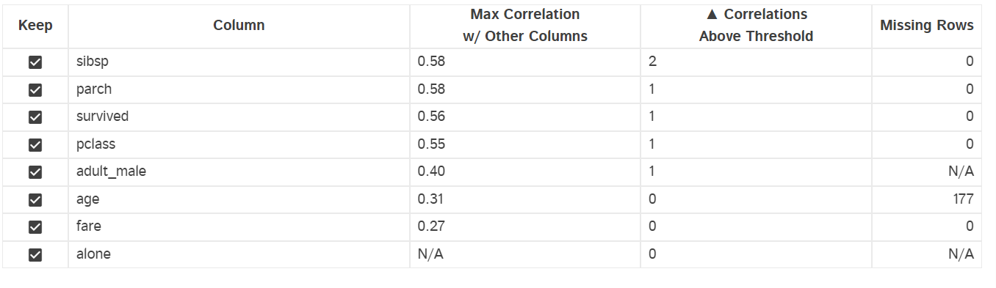
What is the role of threshold in feature engineering

Slide 22
What is skewness
Skewness refers to the asymmetry or lack of symmetry of a distribution.
Positive skewness:
Scores of students in a class - a long tail of higher scores dragging the distribution to the right.
Negative skewness:
Exam scores with a tail of many low failing grades pulling the distribution to the left.

Slide 23
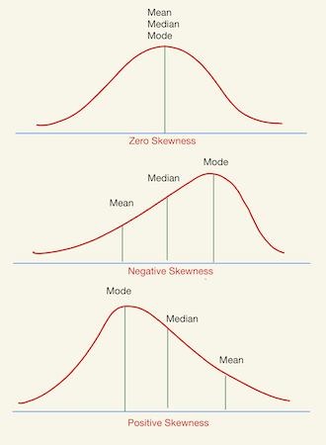
Graphical representation of skewness

Slide 24
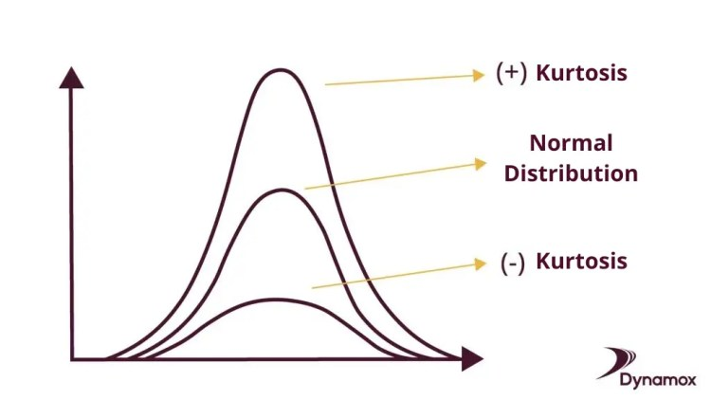
kurtosis

Slide 25
Strategies to remove outliers
Trimming:
Trimming involves simply removing a certain percentage of data points from either end of the dataset.
For example, you can remove the bottom and top 5% of data points, effectively trimming the outliers.
This method is easy to implement and doesn't require complex calculations.

Slide 26
Strategies to resolve null values
Deletion:
Remove rows or columns with null values.
Use this strategy when null values are few and won't significantly affect the analysis.
Imputation with Central Tendency:
Replace null values with the mean, median, or mode of the respective column.
This approach is simple and effective for numerical or categorical data.

Slide 27
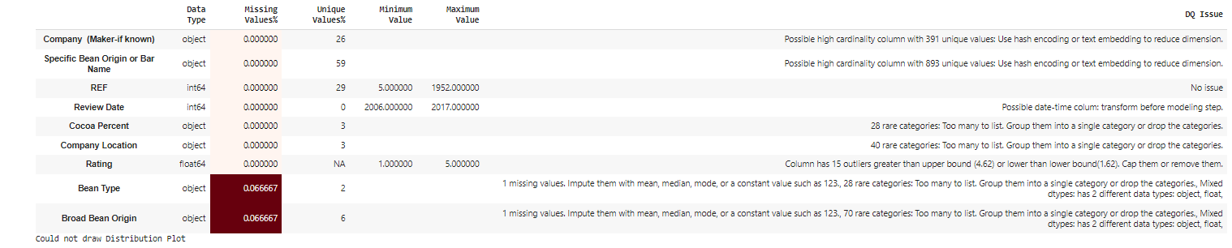
Autoviz report interface

Slide 28
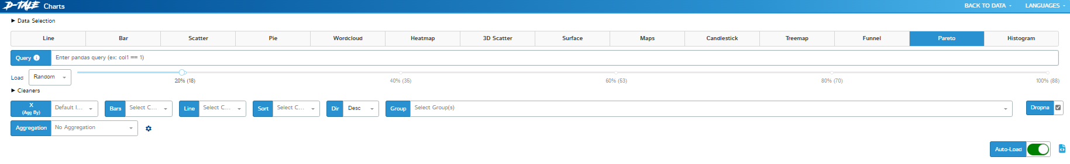
Dtale interface

Slide 29
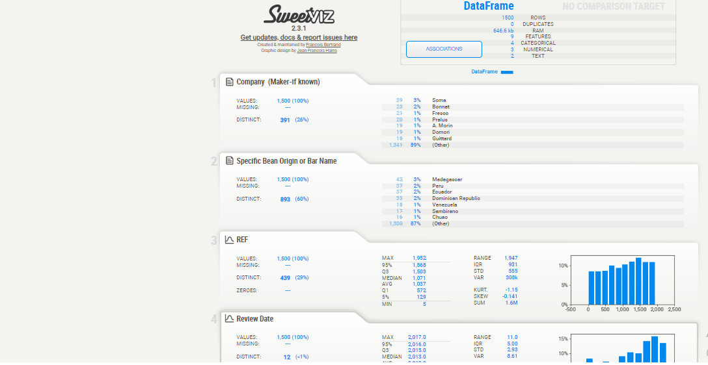
Sweetviz report interface

Slide 30
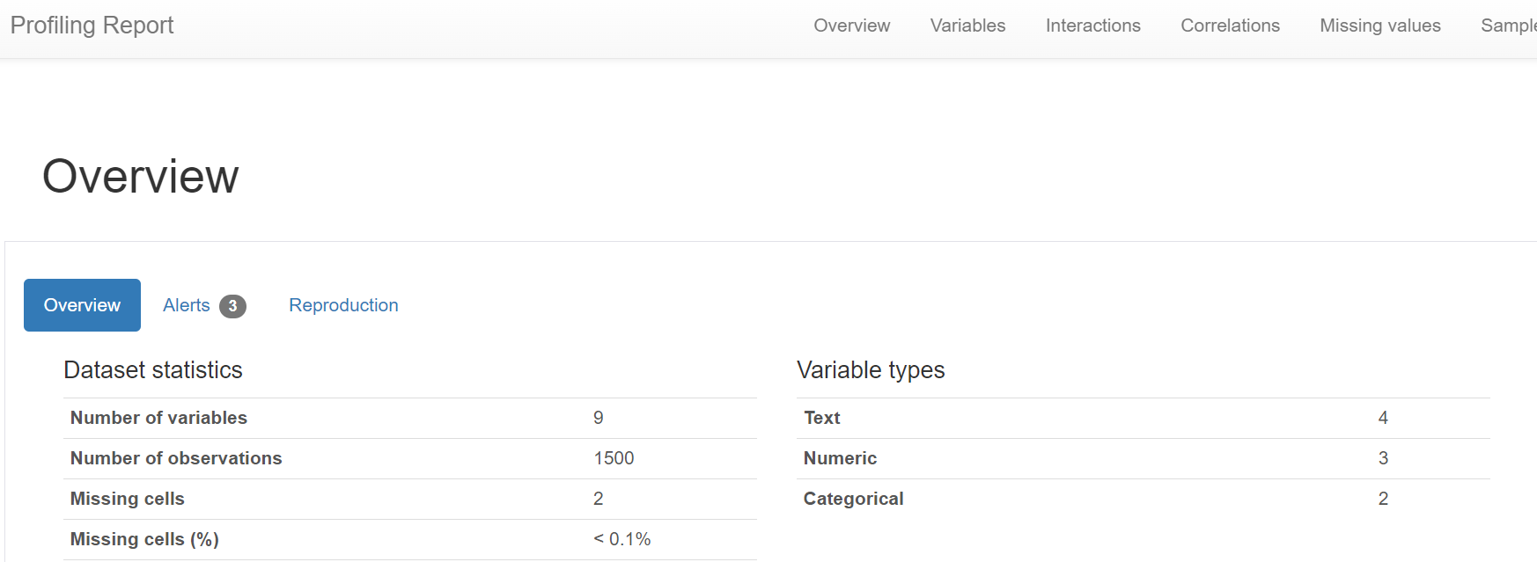
Pandas profiling report

Slide 31

tasks

Slide 32
Task perform on diabetes dataset
Data Profiling:
Perform a basic data profiling to understand the structure of the dataset, including the number of rows, columns, and data types.
Identify the target variable and the predictor variables.
Compute summary statistics (mean, median, standard deviation, etc.) for each numerical variable.
Identify missing values and their distribution across variables.

Slide 33
Task perform on diabetes dataset
Feature Correlation:
Calculate pairwise correlation coefficients between all numerical variables.
Create a correlation matrix and visualize it using a heatmap.
Identify highly correlated variables and discuss their potential impact on model performance.

Slide 34
Task perform on diabetes dataset
Outlier Detection:
Identify potential outliers in the dataset using appropriate techniques, such as box plots, scatter plots.
Visualize the distribution of each numerical variable to identify any extreme values.
Discuss the potential impact of outliers on the analysis and modeling process.

Slide 35
Task perform on diabetes dataset
Target Variable Analysis:
Analyze the distribution of the target variable (diabetes or non-diabetes).
Visualize the target variable distribution using a histogram or a bar chart.
Identify any potential imbalance in the target variable and discuss its impact on model performance.

